Slide 1

Games grade prediction
Or Yehudian and Maor Amar

Slide 2
Table of contents
1. Data Collection
2. Data Cleaning
3. EDA- Visualization
4. Machine Learning
5. Conclusion

Slide 3

The research question
Our research question: Can we predict the grade of a game based on various characteristics
(name of the game, which platform it is suitable for, number of comments, number of likes, ...)
and examining their effect on the grade.

Slide 4

Data Collection

Slide 5

Data Collection -Crawling
In our work, we collected the data, by using crawling.
We collected the data from GameSpot website.
First, we scraped the data in the start page.
Second, we scraped more data from links and extracted all the data we needed.
Link to the data source:
https://www.gamespot.com/games/reviews/

Slide 6
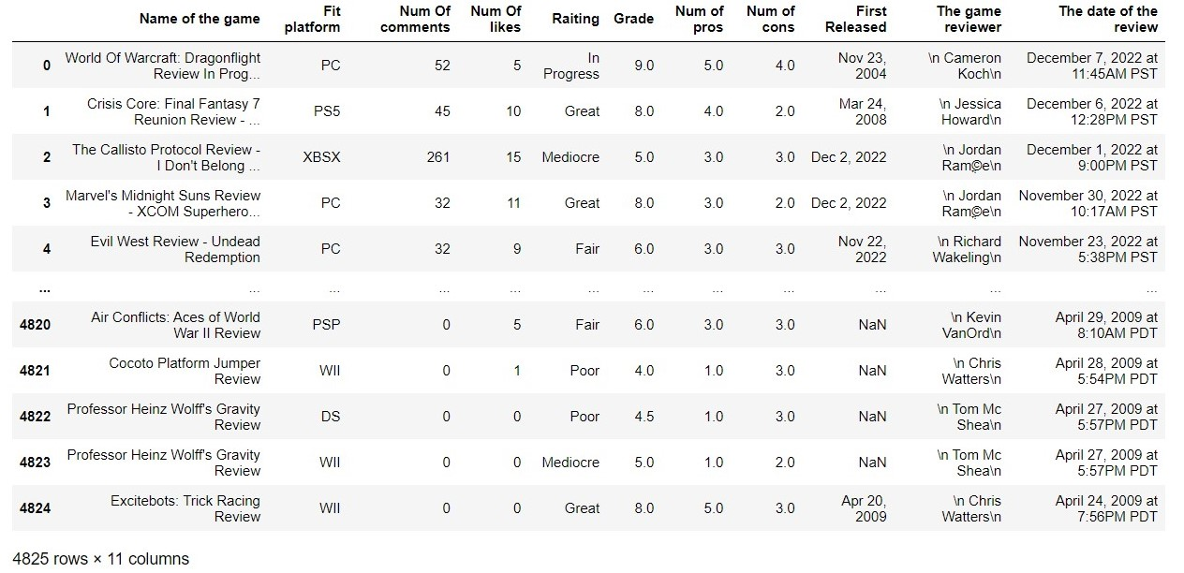
Data set before Cleaning

Slide 7

Data Cleaning

Slide 8
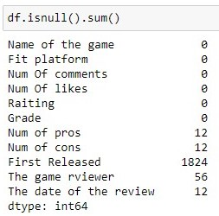
Data cleaning-steps
In data cleaning, we have few steps:
Drop nulls
Drop duplicates
Dealing with outliers
Converting string columns to numeric

Slide 9









Data cleaning problems
We had some issues that we needed to fix:
The date of the game's release.
The release date of the review.
Remove "\n" from The game reviewer column .
Delete the rows with the years above 2022.
Changing fit platform types to the amount each game can fit.

Slide 10
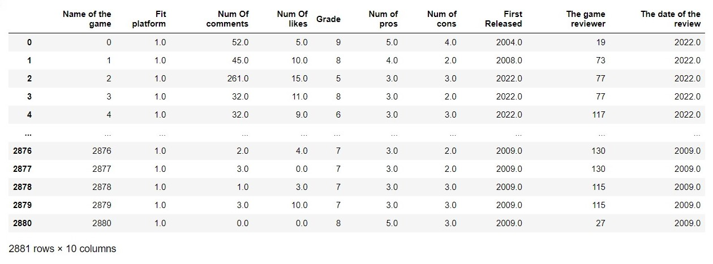
Data set after Cleaning

Slide 11

EDA -Exploratory Data Analysis

Slide 12
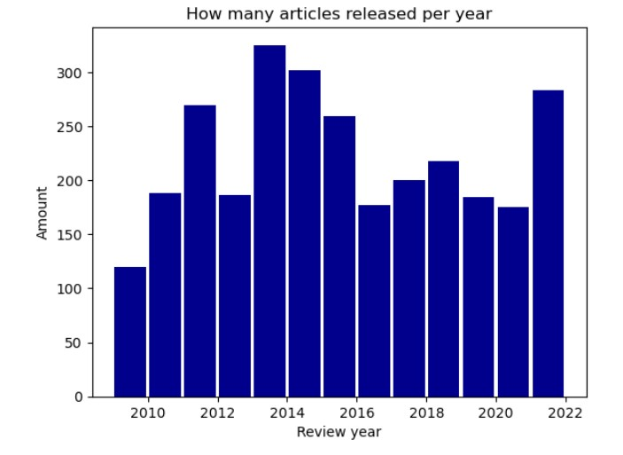
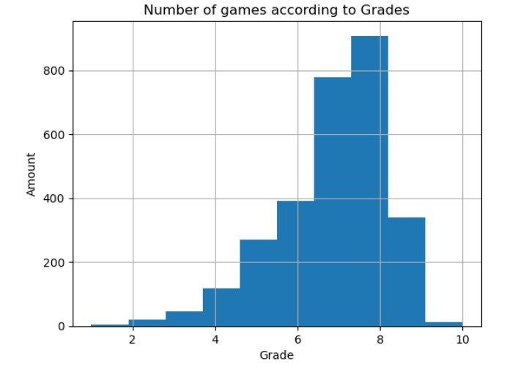
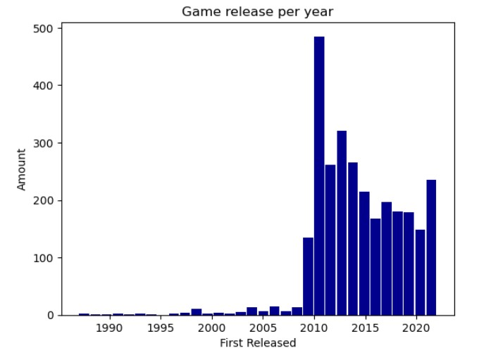
A histogram graph showing the number of articles per year.
A histogram graph showing the number of games in each grade.
A histogram graph showing the number of games released each year.

Slide 13
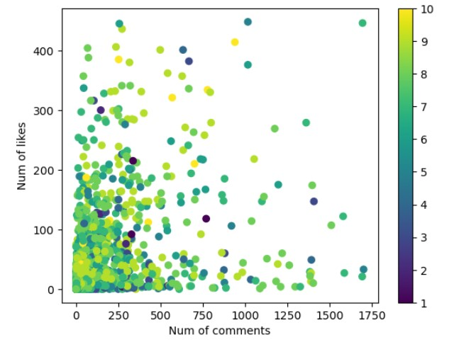
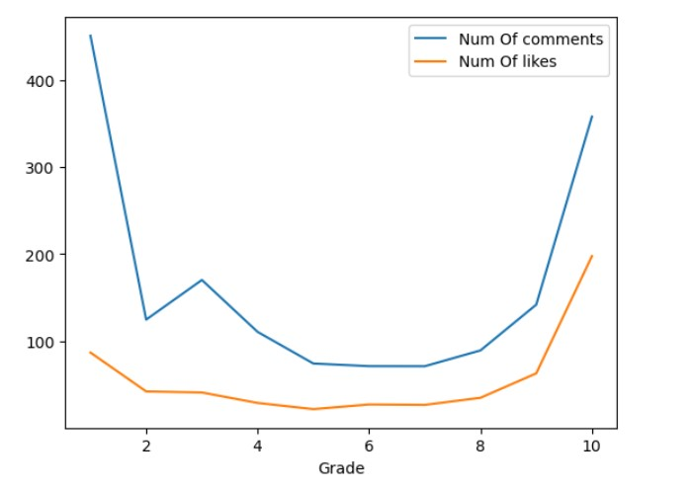
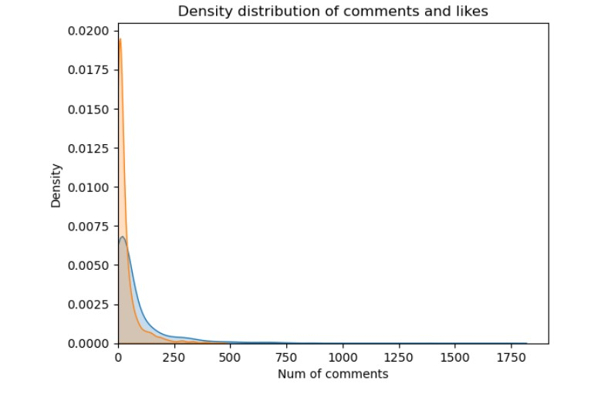
Graphs showing the grade comparing the num of comments and likes
Using the scatter you can see the relationship between the number of comments, the number of likes and the grade of the game.
we can see that the number of comments when the grade is low and when the grade is high is the same. It is possible to distinguish cases where a game is good and receives many good comments versus a game that is not good and receives many negative comments.
We see the density of the number of comments and the number of likes when the density is high in low grades.

Slide 14
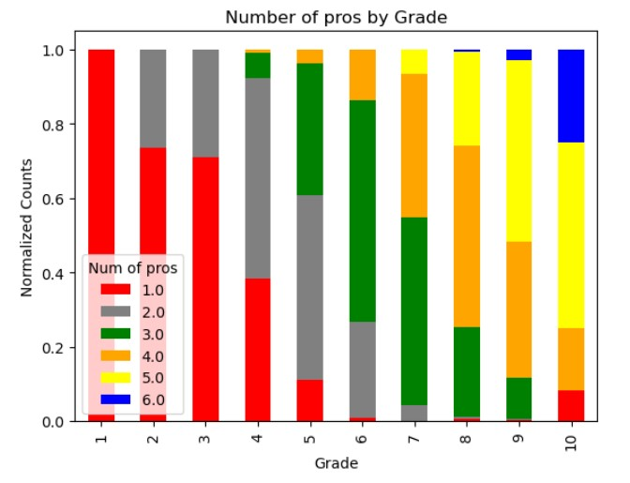
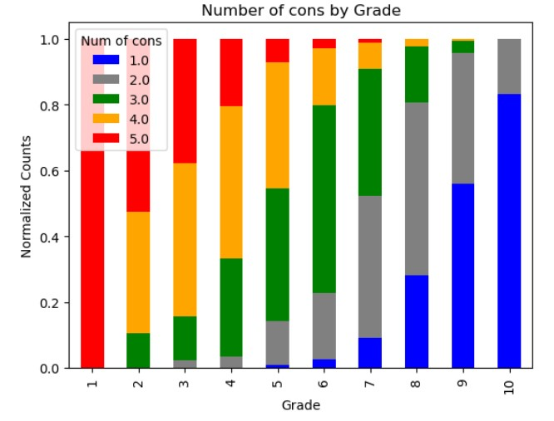
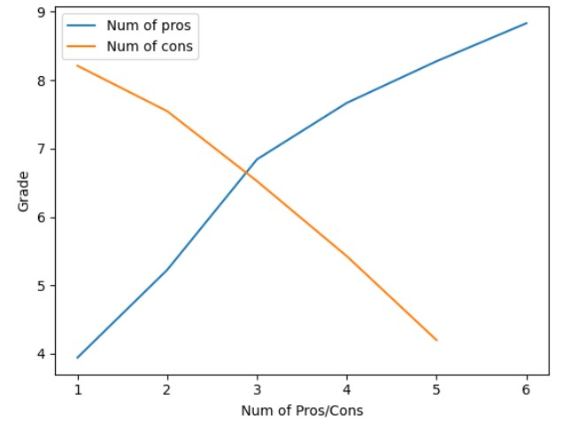
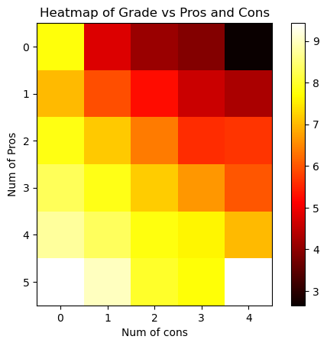
Graphs showing the grade comparing the number of pros and cons according to the author of the review.
We see that the more pros, the higher the grade, and the more cons, the lower the grade.

Slide 15

Machine Learning

Slide 16
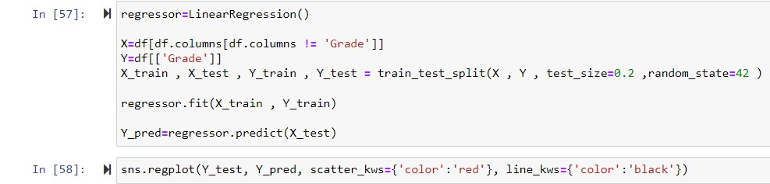
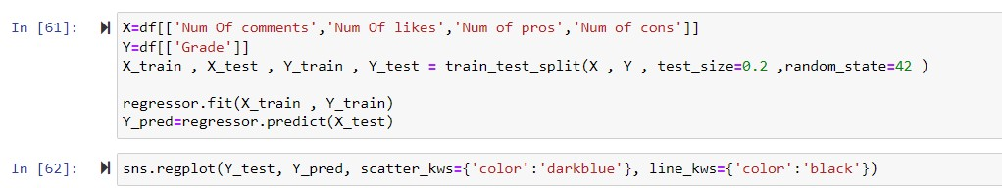
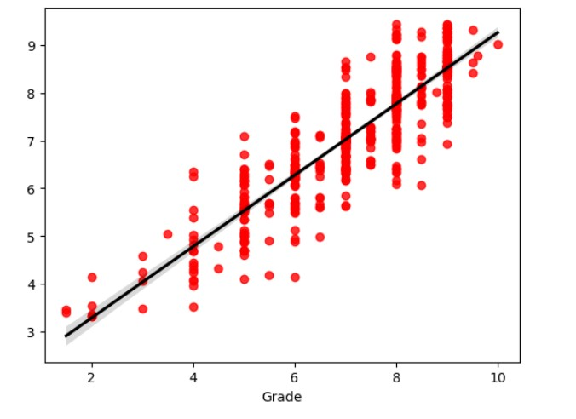
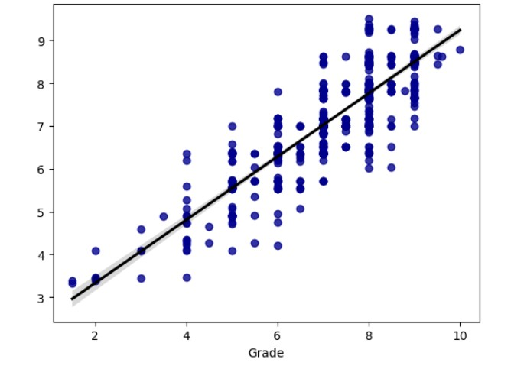
Linear regression
Test 1
Test 2
0.75
0.74

Slide 17
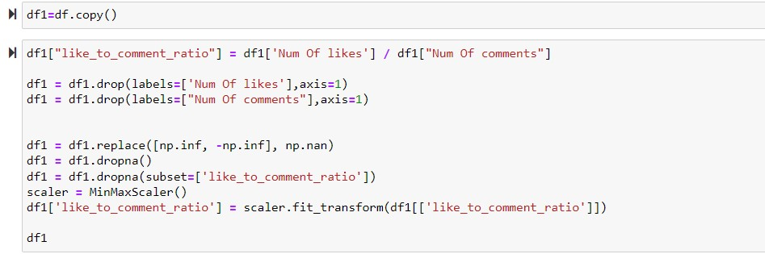
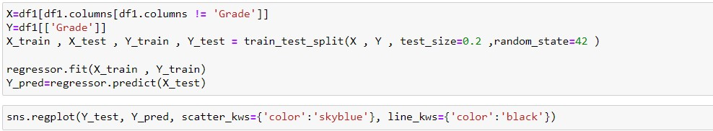
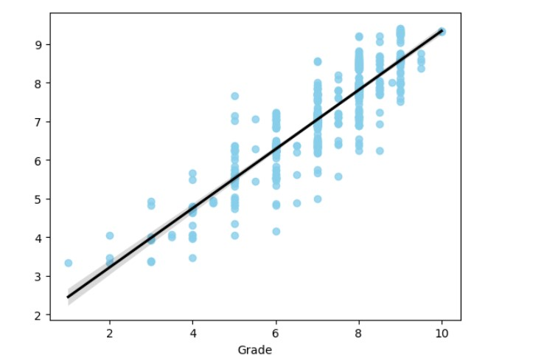
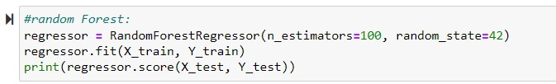
Test 3
Cleaning
We managed to improve the prediction model
Another algorithm for predicting the model
0.78
0.78

Slide 18
Conclusions
To conclude, we researched a topic that really interested us, and we discovered a relationship between the number of comments, likes, positive and negative reviews of those who published the review on predicting the grade of the game.

